Slide 1

Sir Syed University of Engineering & Technology, Karachi
CS-468 Software Quality Assurance & Testing
Week 3
Session 1 & Session 2

Slide 2
5 Views of Software Quality ...
Due to the widespread of computers, there has been increasing customer expectations in terms of better quality in software products, and developers are under tremendous pressure to deliver high-quality products at a lower cost.
Even though competing products deliver the same functionalities, it is the lower cost products with better quality attributes that survive in the competitive market.
Therefore, all stakeholders—users, customers, developers, testers, and managers—in a product must have a broad understanding of the overall concept of software quality.
A number of factors influence the making and buying of software products. These factors are user’s needs and expectations, the manufacturer’s considerations, the inherent characteristics of a product, and the perceived value of a product.
To be able to capture the quality concept, it is important to study quality from a broader perspective.

Slide 3
... 5 Views of Software Quality ...
Transcendental View:
In the transcendental view quality is something that can be recognized through experience but is not defined in some well-mannered form.
Quality is viewed to be something ideal, which is too complex to lend itself to be precisely defined.
However, a good-quality object stands out, and it is easily recognized.
Because of the philosophical nature of the transcendental view, no effort is made to express it using concrete measures.

Slide 4
... 5 Views of Software Quality ...
User View:
The user view concerns the extent to which a product meets user needs and expectations.
Quality is not just viewed in terms of what a product can deliver, but it is also influenced by the service provisions in the sales contract.
In this view, a user is concerned with whether or not a product is fit for use. This view is highly personalized in nature.
The user view can encompass many subjective elements apart from the expected functionalities central to user satisfaction. Examples of subjective elements are usability, reliability, etc.

Slide 5
... 5 Views of Software Quality ...
Manufacturing View:
The manufacturing view has its genesis in the manufacturing sectors, such as the automobile and electronics sectors.
In this view, quality is seen as conforming to requirements.
Any deviation from the stated requirements is seen as reducing the quality of the product.
The concept of process plays a key role in the manufacturing view. Products are to be manufactured “right the first time” so that development cost and maintenance cost are reduced.

Slide 6
... 5 Views of Software Quality ...
Product View:
The central hypothesis in the product view is this: If a product is manufactured with good internal properties, then it will have good external qualities.
An example of the product view of software quality is that high degree of modularity, which is an internal property, makes a software testable and maintainable.

Slide 7
... 5 Views of Software Quality
Value-based View:
The value-based view represents a merger of two independent concepts: excellence and worth.
Quality is a measure of excellence, and value is a measure of worth. The central idea in the value-based view is how much a customer is willing to pay for a certain level of quality.
The reality is that quality is meaningless if a product does not make economic sense.
Essentially, the value-based view represents a trade-off between cost and quality.

Slide 8
The need for comprehensive requirements documents and their contents...
There is a need for a comprehensive definition of requirements that will cover all attributes of software and aspects of the use of software, including usability aspects, reusability aspects, maintainability aspects, and so forth in order to assure the full satisfaction of the users.
Many cases of low customer satisfaction are situations where software projects have satisfactorily fulfilled the basic requirements of correctness, while suffering from poor performance in other important areas such as maintenance, reliability, software reuse, or training.
One of the main causes for these lapses is the lack of defined requirements pertaining to these aspects of software functionality.
Therefore, there is a need for the comprehensive definition of requirements that will cover all aspects of software use throughout all stages of the software life cycle.

Slide 9
... The need for comprehensive requirements documents and their contents.
The great variety of issues related to the various attributes of software and its use and maintenance, as defined in software requirements documents, can be classified into content groups called quality factors.
We expect the team responsible for defining the software requirements of a software system to examine the need to define the requirements that belong to each factor.
Software requirement documents are expected to differ in the emphasis placed on the various factors, a reflection of the differences to be found among software projects. Thus, we can expect that not all the factors will be universally “represented” in all the requirements documents.

Slide 10
The structure (categories and factors) of McCall’s classic factor model
Several models of software quality factors and their categorization in factor categories have been suggested over the years.
The classic model of software quality factors, suggested by McCall, consists of 11 quality factors
The 11 factors are grouped into three categories:
Product operation,
product revision
and product transition.

Slide 11
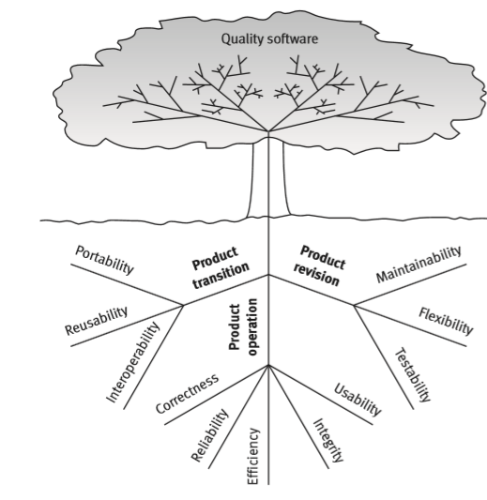
McCall’s factor model tree.

Slide 12
Product operation software quality factors …
According to McCall’s model, five software quality factors are included in the product operation category, all of which deal with requirements that directly affect the daily operation of the software.
These factors are as follows:
Correctness
Reliability
Efficiency
Integrity
Usability

Slide 13
… Product operation software quality factors …
Correctness:
Correctness requirements are defined in a list of the software system’s required outputs.
Such as a query display of a customer’s balance in the sales accounting information system.
Output specifications are usually multidimensional; some common dimensions include:
The required accuracy of those outputs that can be adversely affected by inaccurate data or inaccurate calculations.
The completeness of the output information, which can be adversely affected by incomplete data.
The up-to-dateness of the information (defined as the time between the event and its consideration by the software system).
The availability of the information (the reaction time, defined as the time needed to obtain the requested information or as the requested reaction time of the firmware installed in a computerized apparatus).
The standards for coding and documenting the software system.

Slide 14
… Product operation software quality factors …
Reliability:
Reliability requirements deal with failures to provide service.
They determine the maximum allowed software system failure rate, and can refer to the entire system or to one or more of its separate functions.

Slide 15
… Product operation software quality factors …
Efficiency:
Efficiency requirements deal with the hardware resources needed to perform all the functions of the software system in conformance to all other requirements.
The main hardware resources to be considered are the computer’s processing capabilities (measured in MIPS – million instructions per second, MHz or megahertz – million cycles per second, etc.),
its data storage capability in terms of memory and disk capacity (measured in MBs – megabytes, GBs – gigabytes, TBs – terabytes, etc.) and the data communication capability of the communication lines (usually measured in KBPS – kilobits per second, MBPS – megabits per second, and GBPS – gigabits per second).
The requirements may include the maximum values at which the hardware resources will be applied in the developed software system or the firmware.
Another type of efficiency requirement deals with the time between recharging of the system’s portable units, such as, information systems units located in portable computers, or meteorological units placed outdoors.

Slide 16
… Product operation software quality factors …
Integrity:
Integrity requirements deal with the software system security,
that is, requirements to prevent access to unauthorized persons,
to distinguish between the majority of personnel allowed to see the information (“read permit”)
and a 403 Software quality factors limited group who will be allowed to add and change data (“write permit”), and so forth.

Slide 17
… Product operation software quality factors …
Usability:
Usability requirements deal with the scope of staff resources needed to train a new employee and to operate the software system.

Slide 18
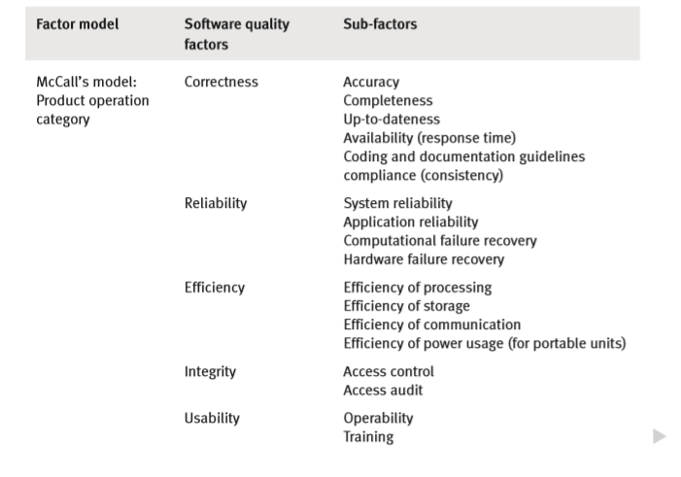
… Product operation software quality factors.

Slide 19
Product revision software quality factors …
According to the McCall model of software quality factors, following three quality factors comprise the product revision category.
Maintainability
Flexibility
Testability
These factors deal with those requirements that affect the complete range of software maintenance activities:
corrective maintenance (correction of software faults and failures),
adaptive maintenance (adapting the current software to additional circumstances and customers without changing the software)
and perfective maintenance (enhancement and improvement of existing software with respect to locally limited issues).

Slide 20
… Product revision software quality factors …
Maintainability:
Maintainability requirements determine the efforts that will be needed by users and maintenance personnel to identify the reasons for software failures, to correct the failures, and to verify the success of the corrections.
This factor’s requirements refer to the modular structure of software, the internal program documentation, and the programmer’s manual, among other items.

Slide 21
… Product revision software quality factors …
Flexibility:
The capabilities and efforts required to support adaptive maintenance activities are covered by the flexibility requirements.
These include the resources (i.e. in man-days) required to adapt a software package to a variety of customers of the same trade, of various extents of activities, of different ranges of products and so on.
This factor’s requirements also support perfective maintenance activities, such as changes and additions to the software in order to improve its service and to adapt it to changes in the firm’s technical or commercial environment.

Slide 22
… Product revision software quality factors …
Testability:
Testability requirements deal with the testing of an information system as well as with its operation.
Testability requirements for the ease of testing are related to special features in the programs that help the tester, for instance by providing predefined intermediate results and log files.
Testability requirements related to software operation include automatic diagnostics performed by the software system prior to starting the system, to find out whether all components of the software system are in working order and to obtain a report about the detected faults.
Another type of these requirements deals with automatic diagnostic checks applied by the maintenance technicians to detect the causes of software failures.

Slide 23
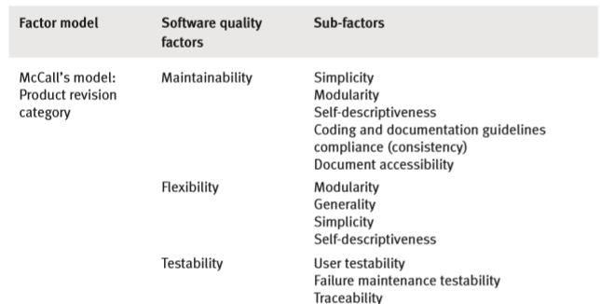
… Product revision software quality factors

Slide 24
Product transition software quality factors …
According to McCall, three quality factors are included in the product transition category, a category that pertains to the adaptation of software to other environments and its interaction with other software systems.
Includes:
Portability
Reusability
Interoperability

Slide 25
… Product transition software quality factors …
Portability:
Portability requirements tend to the adaptation of a software system to other environments consisting of different hardware, different operating systems, and so forth.
These requirements make it possible to continue using the same basic software in diverse situations or to use it simultaneously in diverse hardware and operating systems situations.

Slide 26
… Product transition software quality factors …
Reusability:
Reusability requirements deal with the use of software modules originally designed for one project in a new software project currently being developed.
They may also enable future projects to make use of a given module or a group of modules of the currently developed software.
The reuse of software is expected to save development resources, shorten the development period, and provide higher quality modules.
These benefits of higher quality are based on the assumption that most of the software faults have already been detected by the quality assurance activities performed on the original software, by users of the original software, and during its earlier reuses.

Slide 27
… Product transition software quality factors …
Interoperability:
Interoperability requirements focus on creating interfaces with other software systems or with other equipment firmware (for example, the firmware of the production machinery and testing equipment interfaces with the production control software).
Interoperability requirements can specify the name(s) of the software or firmware for which interface is required.
They can also specify the output structure accepted as standard in a specific industry or applications area.

Slide 28

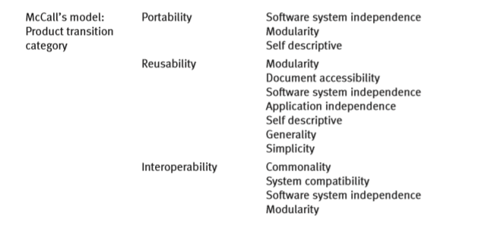
… Product transition software quality factors

Slide 29
Those interested in defining software quality requirements.
The client is not the only party interested in thoroughly defining the requirements that assure the quality of the software product.
The developer is often interested in adding requirements that represent his own interests, such as reusability, verifiability and portability requirements.
These may not, however, be of interest to the client.
Thus, one can expect that a project will be carried out according to two requirements documents:
The client’s requirements document
The developer’s additional requirements document.

